Slide 1
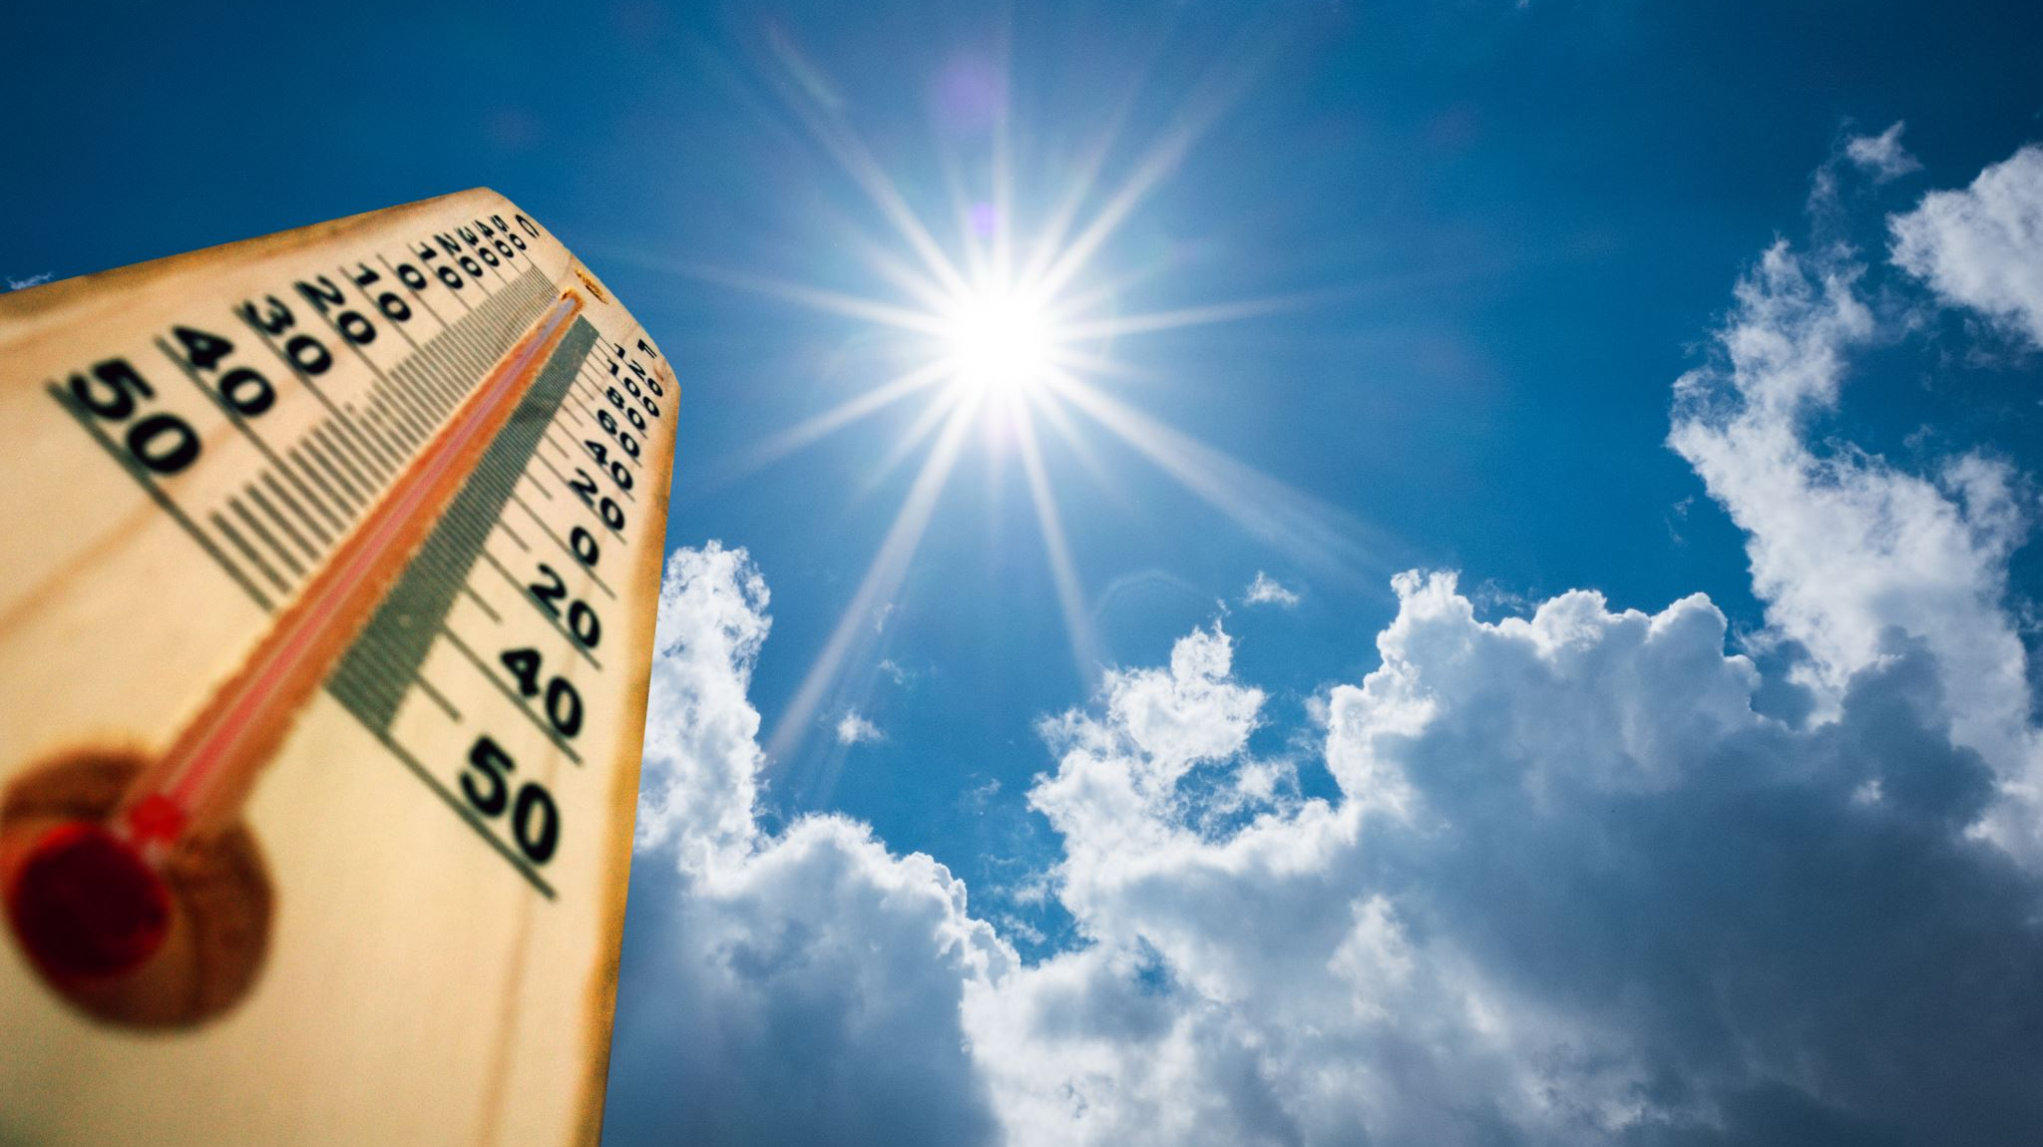
Sun Smart project
Group 24
Stella stiven, Bethany kaye-blake, Neil alombro

Slide 2
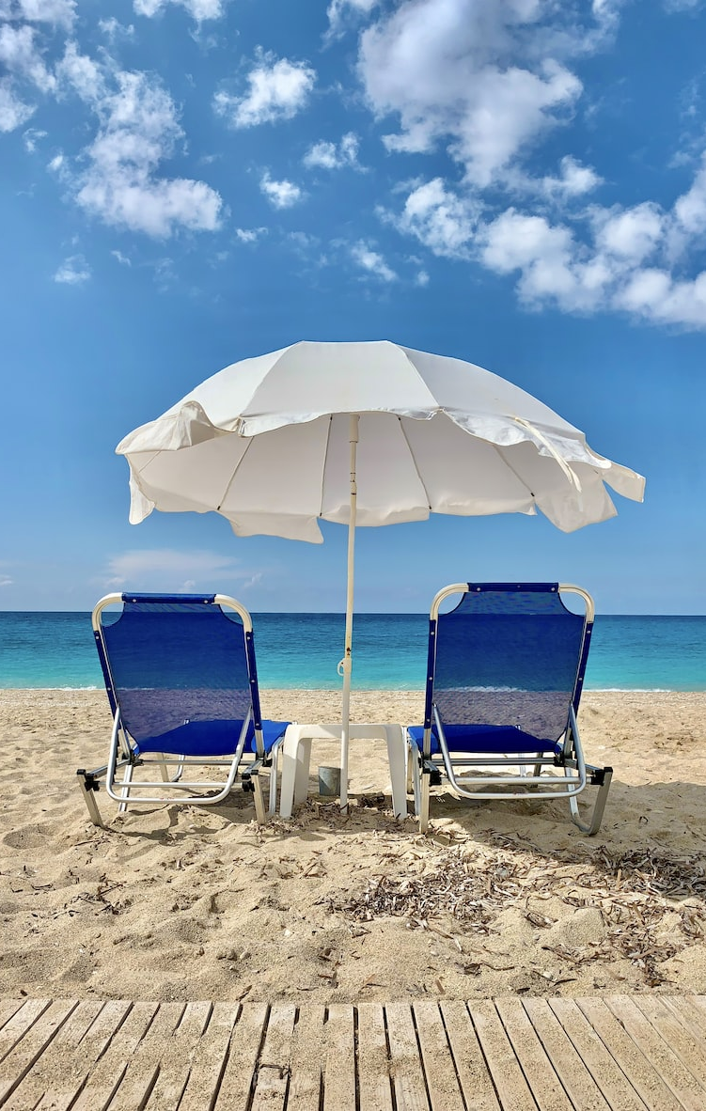
Design Context
Skin cancer is the most common form of cancer in New Zealand (~80%)
Resultant health care costs amount to almost $200 million each year, and is only expected to grow
Our UV levels are higher, so we must be proactive to protect our skin
Notes:
What you're trying to achieve (including the likely market, and any key requirements and specifications)
How your overall design is structured and how it works (it helps here to refer to schematics and other diagrams)
What are the major pieces of your design, and what do they do?
How do the pieces connect together?
How do all of the pieces work together to do what your design is supposed to achieve?
What your rationale was for key decisions
What evidence you have that the design works as intended
Results of analysis or simulation that shows how the design satisfies specifications
A demonstration of your prototype hardware and software

Slide 3
Design aim
What are we trying to achieve?
A portable device that will inform the user of the UV index and alert them when they should be reapplying sunblock or finding shade based off this UV index.
Our device aims to be an opportunity for awareness, as well as a protective measure when in use
Likely market:
Beach goers, people swimming in outside pools, summer sports/spectators, sunbathers
Notes:
What you're trying to achieve (including the likely market, and any key requirements and specifications)
How your overall design is structured and how it works (it helps here to refer to schematics and other diagrams)
What are the major pieces of your design, and what do they do?
How do the pieces connect together?
How do all of the pieces work together to do what your design is supposed to achieve?
What your rationale was for key decisions
What evidence you have that the design works as intended
Results of analysis or simulation that shows how the design satisfies specifications
A demonstration of your prototype hardware and software

Slide 4
Key Requirements
3 main requirements
To educate users about UV Index in New Zealand
To alert users when outside to reapply sun block, or find shade
To utilise the energy from the sun when outside

Slide 5
Key specifications
Arduino can interpret data from UV sensor and change components to appropriate states such as:
Tell RGB LED to light up in the correct colour
Tell the 7-seg what number to display (when button is press AND transducer is OFF)
Tell the transducer when to buzz (and turn off when button is pressed)
Solar panel needs to provide enough power to the Arduino on a sunny day (5V and 250mA)
Solar panel is rated 5.5V and 270mA average
Notes:
ADD MORE IF YOU THINK OF ANY!!!!

Slide 6
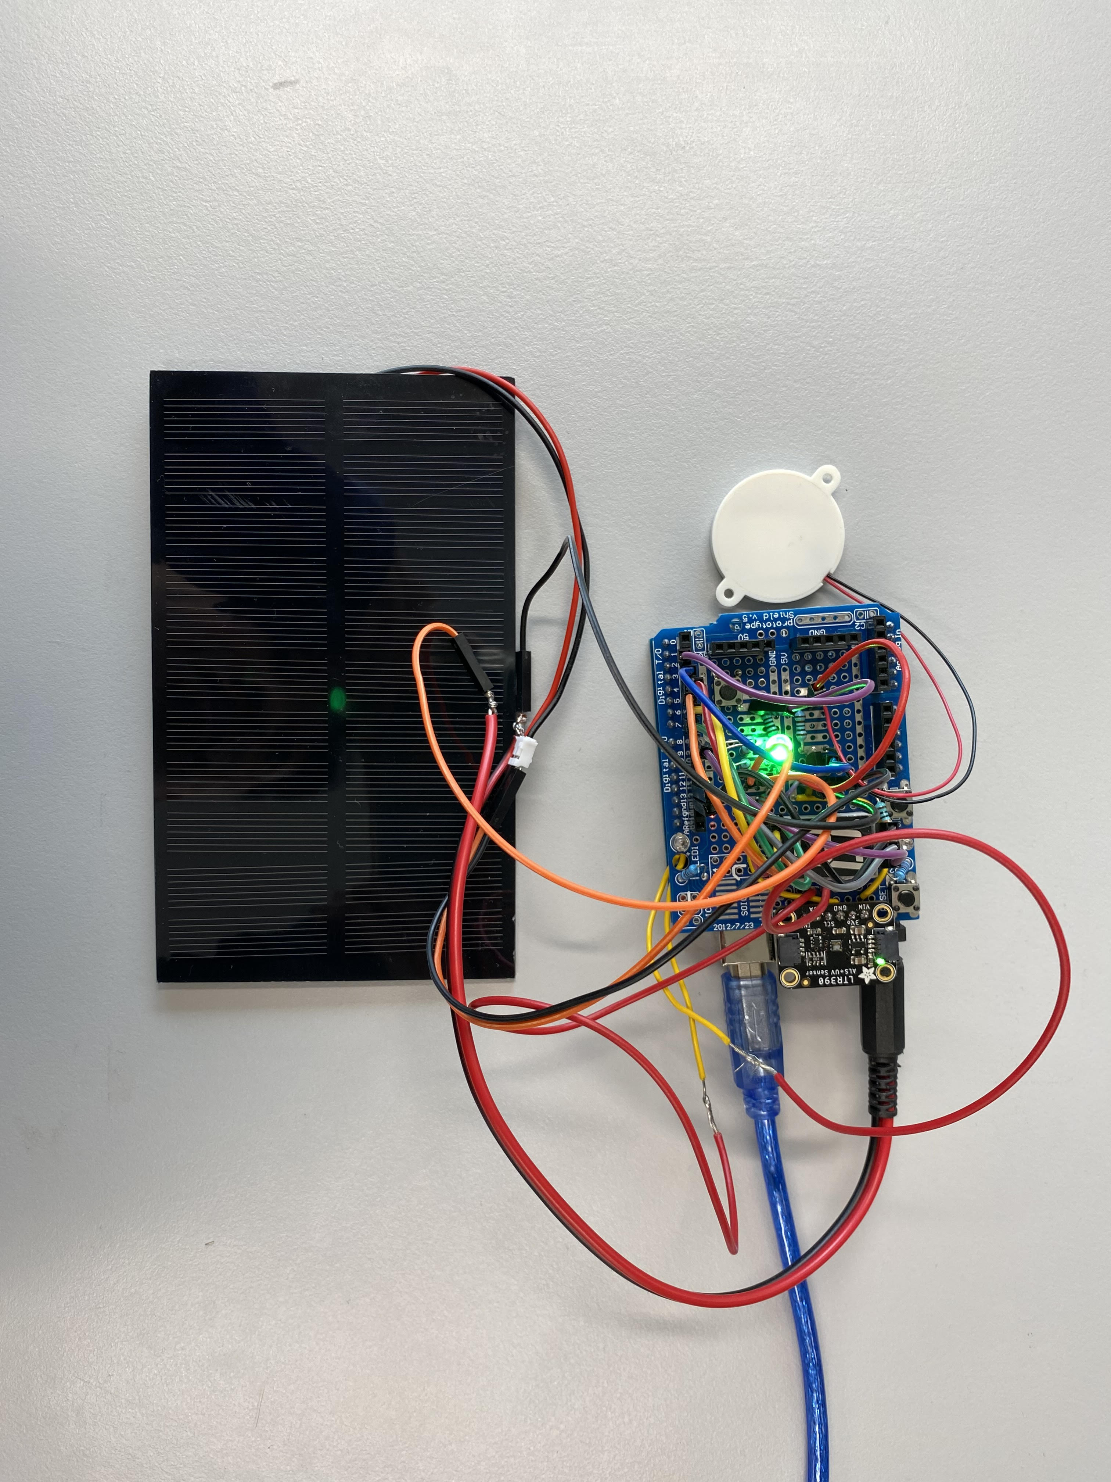
Overall design
Power Source: Solar Cell
Shield Design
Stand
Arduino
Notes:
What your rationale was for key decisions
What evidence you have that the design works as intended
Results of analysis or simulation that shows how the design satisfies specifications
A demonstration of your prototype hardware and software

Slide 7
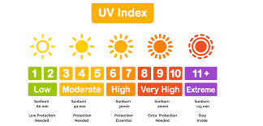
How it works
UV sensor reads wavelength of UV radiation
Arduino records the measurement from the UV sensor every 60 seconds
Arduino calculates the average UV index
The calculation bases the indicator on 100 UV index points based on research.
Transducer buzzes when it is recommended to reapply more sunscreen for the UV index
When transducer is ON: Button pushed = transducer turns off
When transducer is OFF: Button pushed = UV index number on display turns on
LED is always on and lit up in the UV index colour
This colour will update every 60 seconds when Arduino records the measurement from the UV sensor
Notes:
What your rationale was for key decisions
What evidence you have that the design works as intended
Results of analysis or simulation that shows how the design satisfies specifications
A demonstration of your prototype hardware and software

Slide 8
Design: shield design
Main Components
Appropriate access to components
Consistent Power supply
Button
Digital Data
Arduino UNO Microcontroller
(Electronic Data Recorder)
RGB LED
Digital Data
UV Sensor
Measurement
Digital Data
7 Segment Display
Solar Panel
1.5W Power
Digital Data
Transducer
1.5W Power
Notes:
Main Components:
Power
Measurements: UV Detector
Information: RGB LED & 7 Segment Display
Alert: Transducer
Component access:
Button
Readability of 7 seg
Attachability of solar cell

Slide 9
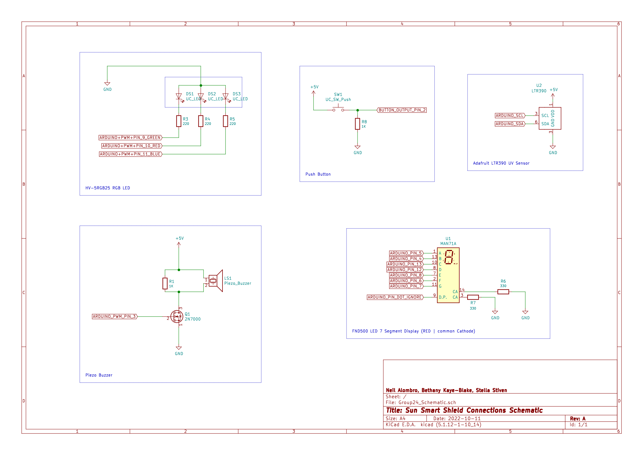

Slide 10
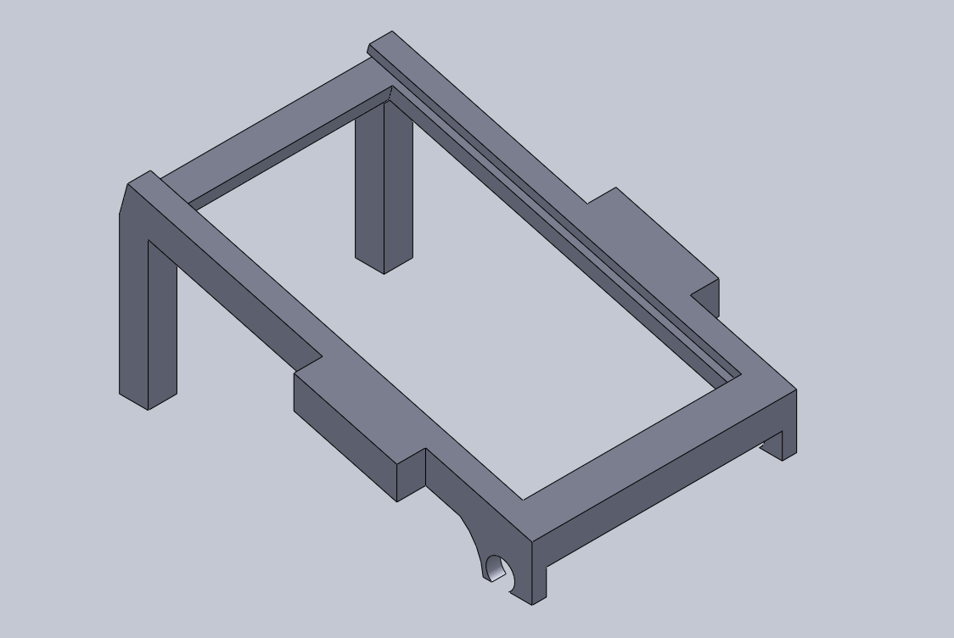
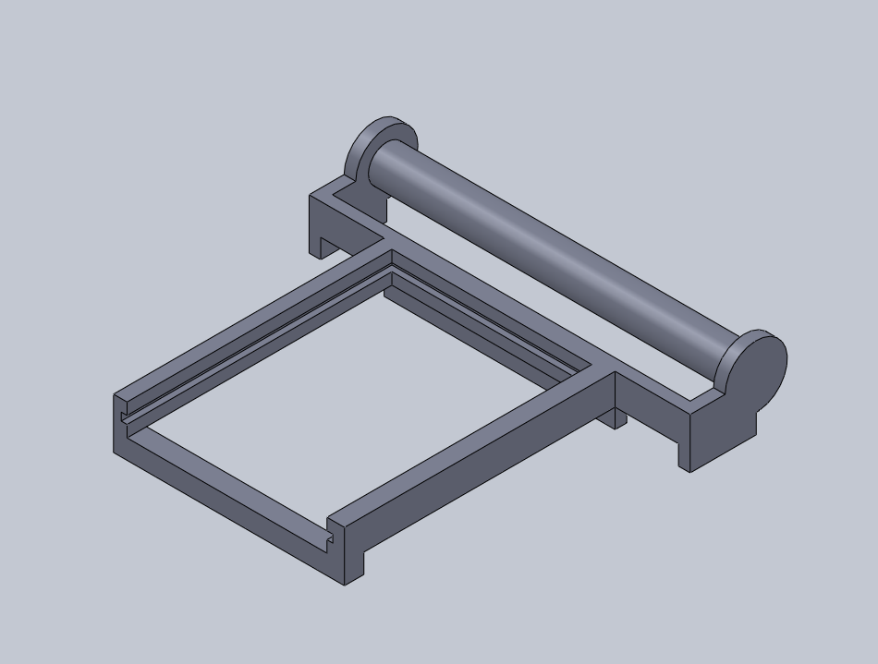
Design: compact stand

Slide 11
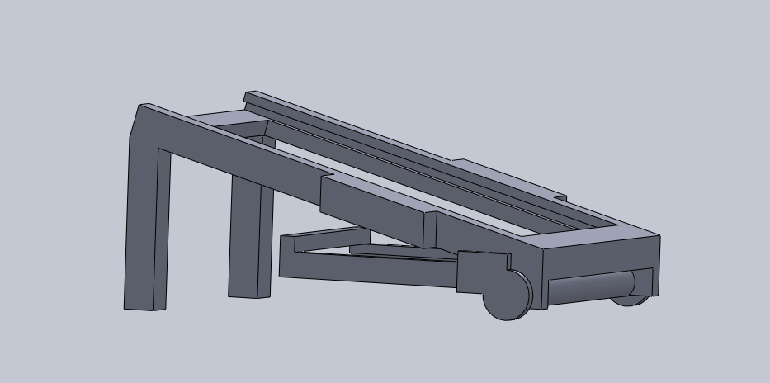
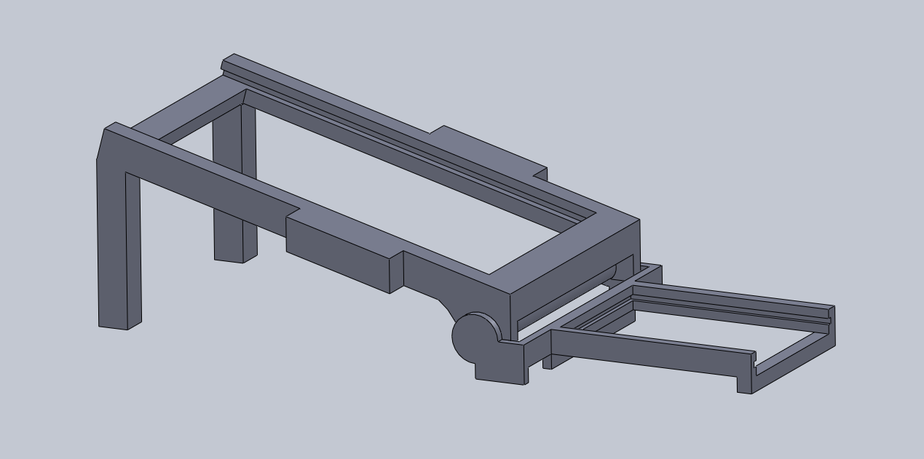
Design: compact stand

Slide 12
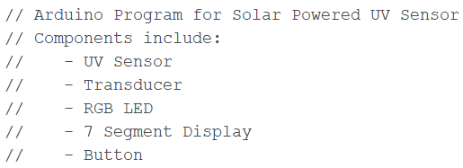
Design structure: software
Modular software design allowed for individual component testing then debugging with overall robot system.
Using Arduino code to combine all components to operate together.
SUFFICIENT_UV
Do:
buzz_on = true;
analogWrite(buzz_pin, 127);
rgb_color(255, 0, 1); // Red
delay(100);
rgb_color(0, 0, 0); // Blank
total_uv >= 100
button_state = HIGH
Do:
buzz_on = true
INSUFFICIENT_UV

Slide 13
Do:
buzz_on = true;
analogWrite(buzz_pin, 127);
rgb_color(255, 0, 1); // Red
delay(100);
rgb_color(0, 0, 0); // Blank
SUFFICIENT_UV
time_since_last_buzz >= 100
button_state = HIGH
INSUFFICIENT_UV
Do:
buzz_on = false
analogWrite(buzz_pin, 0);
time_since_last_buzz = 0;
display_seg_and_rgb(uv_index);

Slide 14
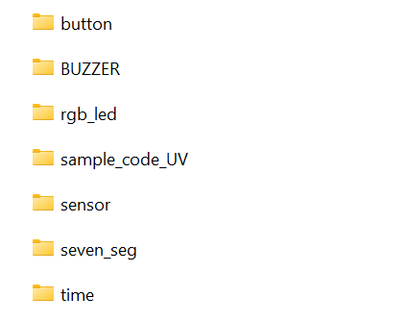
Separate software tests for each component.
Useful for debugging and cascading software for overall program.

Slide 15
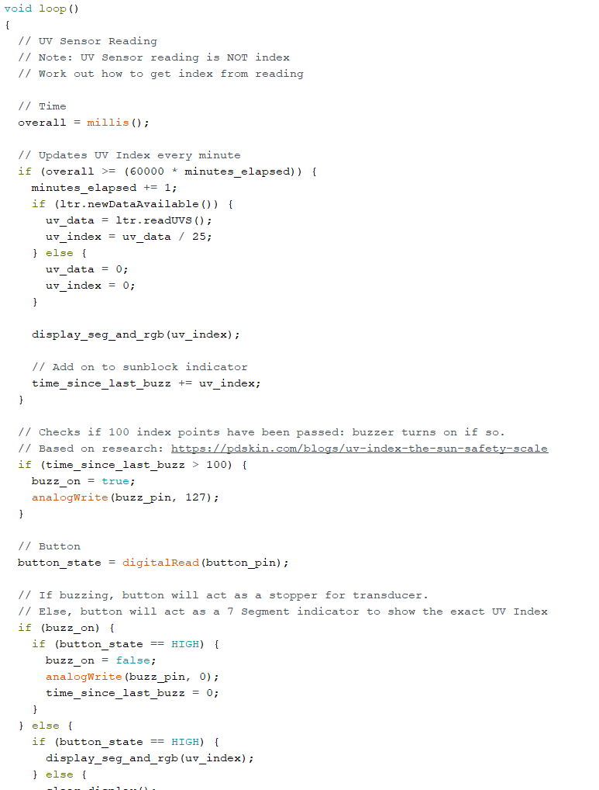
Overall program created from component testing
Updates UV Index every minute
Calculations will alert user for sunblock application.

Slide 16
Software demonstration components

Slide 17
Software demonstration overall program

Slide 18
How well does our design work?
Holding all components
Alternative power supply options (computer through Arduino, 9V battery)
Audible alert (transducer)
Information display (visual 7-seg display and RGB LED)

Slide 19
reflections
Successfully achieves key requirements and specifications
Future improvements include:
Attachments for various applications
Ski helmets, bikes, and other outdoor physical exercises.
Product Development
Microcontroller choices for cost that is better utilized
Developing consistency of voltage from panel and looking into battery storage
Looking for more cost-effective solar solutions
Notes:
3 main requirements
To educate users about UV Index in New Zealand
To alert users when outside to reapply sun block, or find shade
To utilise the energy from the sun when outside

Slide 20
Questions?

